Slide 1
Design - Data warehouse architecture. The star schema.

Slide 2
The Learning Objectives
What is a DW – recap
DW architectures
Design models for DW
  STAR SCHEMA
  SNOW FLAKE
  QSEE NOTATION
Data Maintance - SDC

Slide 3
Recap: What is Data Warehouse?
Defined in many different ways, but not rigorously.
  A decision support database that is maintained separately from the organization’s operational database
  Support information processing by providing a solid platform of consolidated, historical data for analysis.
“A data warehouse is a subject-oriented, integrated, time-variant, and nonvolatile collection of data in support of management’s decision-making process.”—W. H. Inmon
Data warehousing:
  The process of constructing and using data warehouses

Slide 4
Data Warehouse—Subject-Oriented
Organized around major subjects, such as customer, product, sales.
Focusing on the modeling and analysis of data for decision makers, not on daily operations or transaction processing.
Provide a simple and concise view around particular subject issues by excluding data that are not useful in the decision support process.

Slide 5
Data Warehouse—Integrated
Constructed by integrating multiple, heterogeneous data sources
  relational databases, flat files, on-line transaction records
Data cleaning and data integration techniques are applied.
  Ensure consistency in naming conventions, encoding structures, attribute measures, etc. among different data sources
    E.g., Hotel price: currency, tax, breakfast covered, etc.
  When data is moved to the warehouse, it is converted.

Slide 6
Data Warehouse—Time Variant
The time horizon for the data warehouse is significantly longer than that of operational systems.
  Operational database: current value data.
  Data warehouse data: provide information from a historical perspective (e.g., past 5-10 years)
Every key structure in the data warehouse
  Contains an element of time, explicitly or implicitly
  But the key of operational data may or may not contain “time element”.

Slide 7
Data Warehouse—Non-Volatile
A physically separate store of data transformed from the operational environment.
Operational update of data does not occur in the data warehouse environment.
  Does not require transaction processing, recovery, and concurrency control mechanisms
  Requires only two operations in data accessing:
    initial loading of data and access of data.

Slide 8
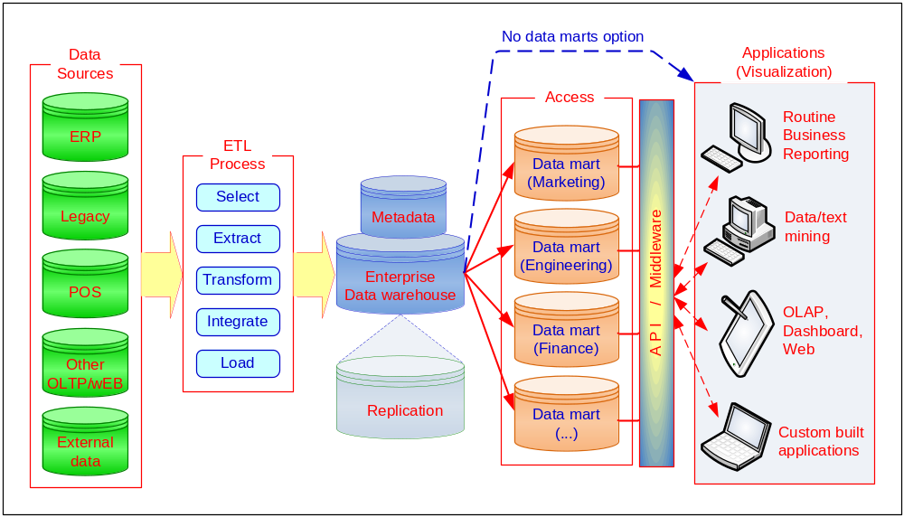
A Conceptual Framework for DW

Slide 9
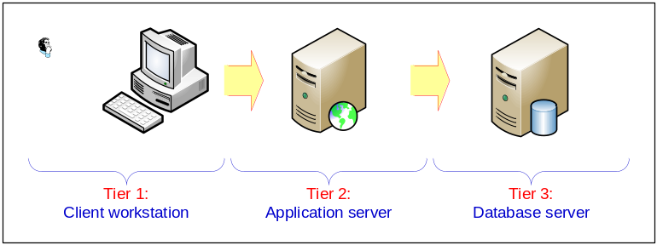
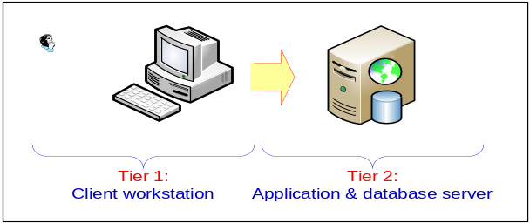
Generic DW Architectures
Three-tier architecture
  Data acquisition software (back-end)
  The data warehouse that contains the data & software
  Client (front-end) software that allows users to access and analyze data from the warehouse
Two-tier architecture
  First 2 tiers in three-tier architecture is combined into one

Slide 10
DW Architecture Considerations
Issues to consider when deciding which architecture to use:
  Which database management system (DBMS) should be used?
  Will parallel processing and/or partitioning be used?
  Will data migration tools be used to load the data warehouse?
  What tools will be used to support data retrieval and analysis?

Slide 11
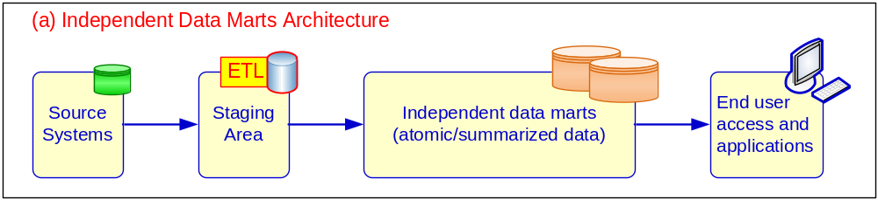
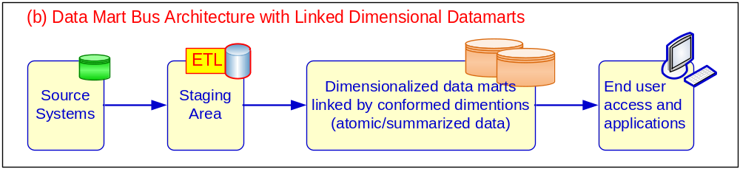
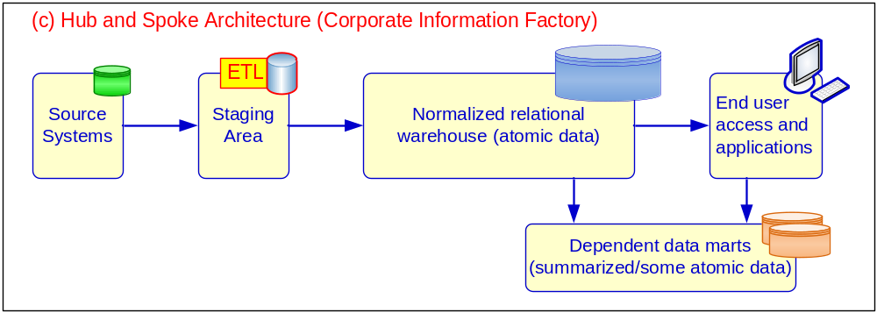
Alternative DW Architectures

Slide 12
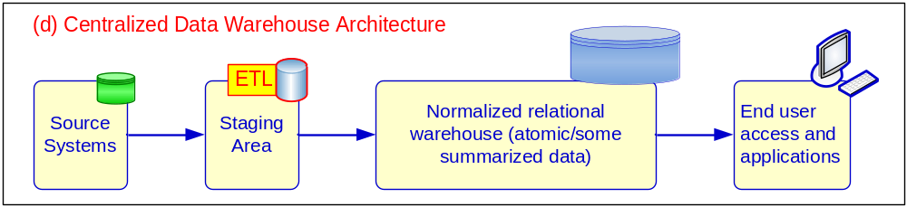
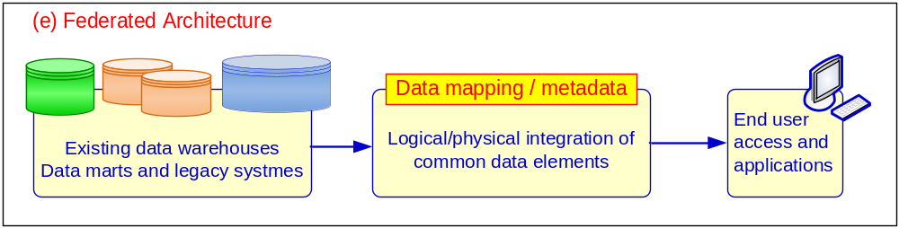
Alternative DW Architectures

Slide 13
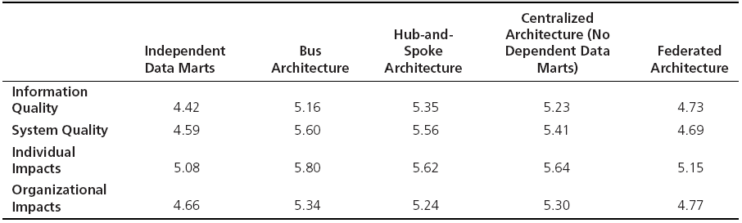
Which Architecture is the Best?
Bill Inmon versus Ralph Kimball
Enterprise DW versus Data Marts approach
Empirical study by Ariyachandra and Watson (2006)

Slide 14
Data Warehouse
Inmon vs Kimball
  “Father of Data warehousing” and “Father of Business Intelligence”
  Both have same goal: support management in decision making
  Single enterprise-wide dw vs. smaller data marts for departmental-level analysis and reporting
  Top-down (single Data warehouse) vs. bottom up (goal Information Bus)
  normaliased (3nf relational model) vs un-normalised multidimensional data (star-schema and snoflakes)
  Both: separate the detailed-level data from aggregated-level data
  Inmon: dw include all possible historical data
  BI = Inmon’s enterprise wide dw + Kimball’s DM + Data mining + unstructured data (term used inconsistently now days)
  Practice today … Inmon or Kimball
  Process influence over Analytics
  50% fail ? Fail to recognize issues with data quality

Slide 15
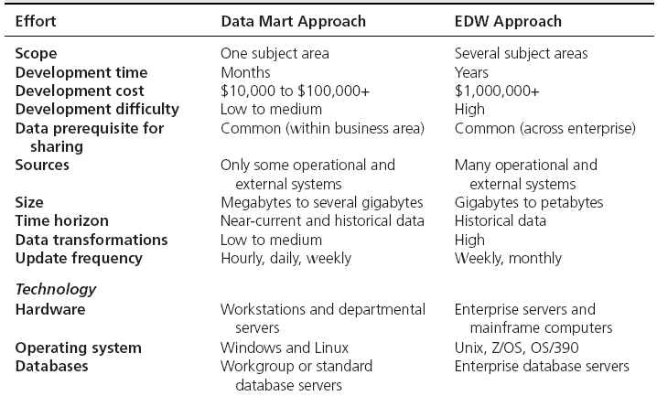
DW Development Approaches
(Kimball Approach) (Inmon Approach)

Slide 16
Data Warehousing Architectures
Ten factors that potentially affect the architecture selection decision:
Information interdependence between organizational units
Upper management’s information needs
Urgency of need for a data warehouse
Nature of end-user tasks
Constraints on resources
Strategic view of the data warehouse prior to implementation
Compatibility with existing systems
Perceived ability of the in-house IT staff
Technical issues
Social/political factors

Slide 17
Conceptual Modelling of Data Warehouses
Modeling data warehouses: dimensions & measures
  Star schema: A fact table in the middle connected to a set of dimension tables
  Snowflake schema: A refinement of star schema where some dimensional hierarchy is normalized into a set of smaller dimension tables, forming a shape similar to snowflake
  Fact constellations: Multiple fact tables share dimension tables, viewed as a collection of stars, therefore called galaxy schema or fact constellation

Slide 18
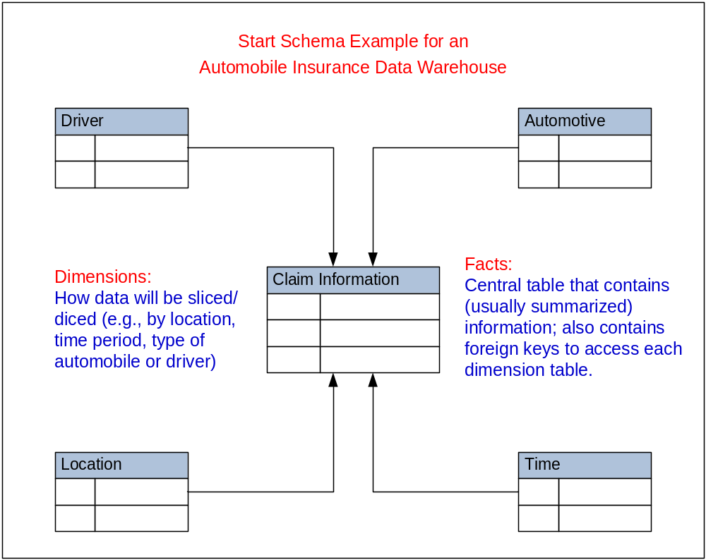
DW Structure: Star Schema
(a.k.a. Dimensional Modeling)

Slide 19
Example of Star Schema
time
time_key
day
day_of_the_week
month
quarter
year
item
item_key
item_name
brand
type
Sales Fact Table
time_key
item_key
branch_key
branch
location
location_key
branch_key
branch_name
branch_type
location_key
street
city
country
units_sold
dollars_sold
avg_sales
Measures

Slide 20
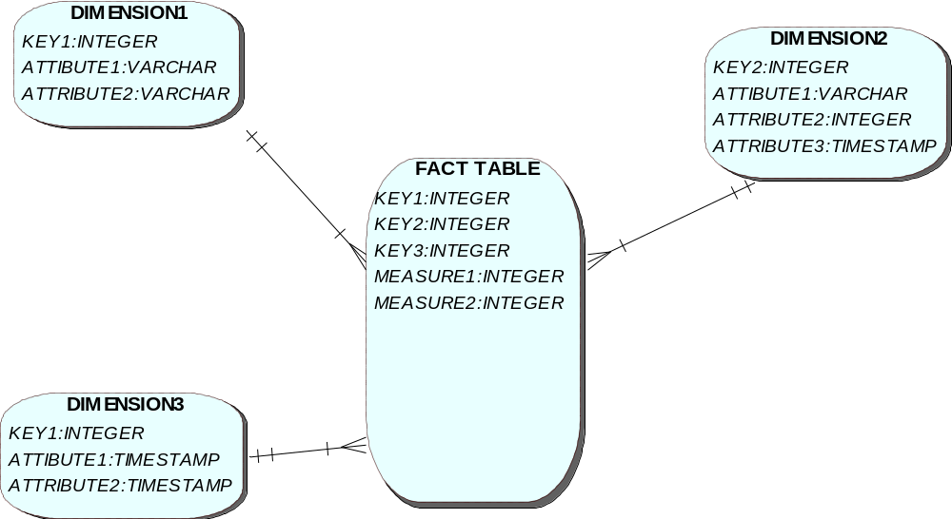
Star Schema – Using QSEE notation

Slide 21
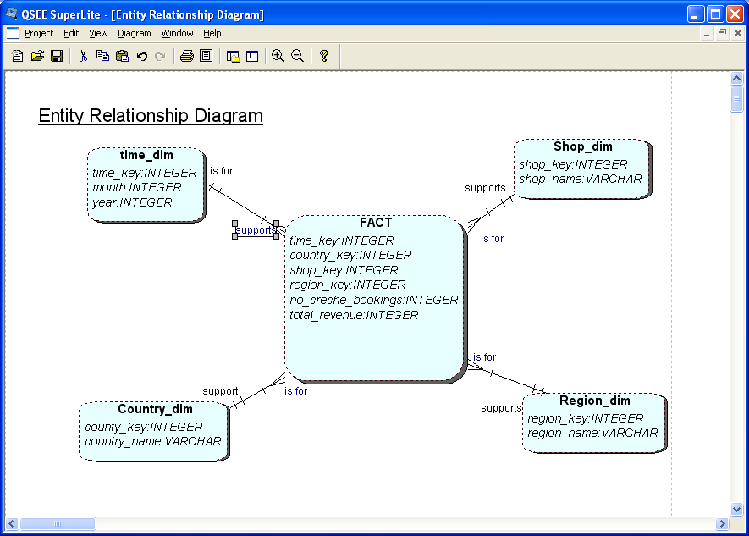
Star schema: Dimensions and FACTs
Notes:
Simple structures for users to understand
Effective data extract achieved through the use of appropriate dimension tables
Aggregated data readily to hand
Drilling possible, as far as data allows
Well tried and understood tools available, both for extracting data and presentation
Drill up/down is slow as requires access to other stars
Drill across and through not so easily understood by users.
Can be problems of scalability
Main point: Needs specific tools (eg better than Access!) if to run efficiently. Eg new forms of indexing of table rows.

Slide 22
Example of Snowflake Schema
supplier
supplier_key
supplier_type
time
item
time_key
day
day_of_the_week
month
quarter
year
item_key
item_name
brand_type
supplier_key
Sales Fact Table
time_key
item_key
branch_key
location
branch
location_key
street
city_key
location_key
branch_key
branch_name
branch_type
units_sold
dollars_sold
avg_sales
city
Measures
city_key
city
province_or_street
country

Slide 23
Warehouse data maintenance
Data refresh
  when to refresh, what form to send inserts?
Materialized view maintenance with batch updates.
Query evaluation using materialized views
Monitoring and reporting tools
Slowly Changing Dimensions (SCD)
  Strategy for dealing with changes of data in transactional db
  Detailed information that we want to keep about these changes in the dw
Much more on SCD in few weeks…
Notes:
In Dimensional Modelling, it has been assumed that dimension values don't change.
But over extended periods of time this is not usually true.
Dimensional attributes do change, even if slowly.
We must have a strategy for handling that change.

Slide 24
Task for the Lecture
Given is this model for Operational sources for LBU business... Data is coming from 2 different sources... 1. Draw an ERD for each system 2. Draw a SS diagram
  Leeds branch
    Customer(custid, name, address, city, phone, DOB, email...
    Product (id, name, description, price
    Agent (agent_no, name, manager, region
    Order (id, order_date, total, notes, quantity, custid, agentid
    ORDER_LINE (orderid, prodid
    Branch(Branch_id, Location
    Manchester branch
    Customer(custid, first_name, sur_name, address, city, email...
    Product (id, name, description, price
    Order (id, date, notes, quantity, total, custid, agentid
    ORDER_LINE(orderid, prodid, date, total_quantity
    Agent (agent_no, name, phone, email, branch_id
    Branch(Branch_id, Location
    These are reports that will be run on the DW...
  Total number of orders made in first quarter of the year, in comparison with last year for each branch?
  Total number of orders made in first quarter of the year, in comparison with last year by agent?
  Who is our best Agent, in the first quarter of this year and most likely to be next year?
  Who is our best customer, in first quarter of this year.

Slide 25
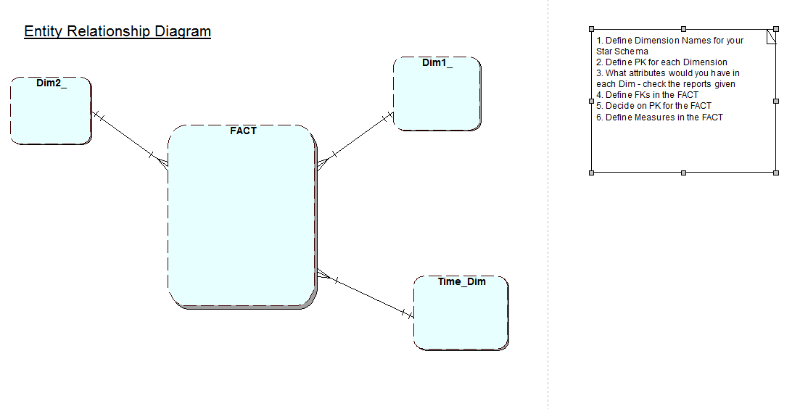
Star Schema template

Slide 26
Summary:
Dimensional Modelling
Star Schema (SS) model used often for DW design
How is data extracted from source
ER Techniques adopted
What are dimensions, fact table, attributes
Fact Table
  Factual or quantitative data
  Generated by events
  Compound primary key - ? Not always!!!
Dimension Tables
  Simple, non-composite Primary Key
  Descriptive
Notes:
Fact table will have attributes such as, quantity sold, orders made, products produced, appointments made.
The compound key is made up of the Foreign keys being the primary keys of the …
Dimension tables
Hold descriptive data about the subject.

Slide 27


End of the Chapter

Slide 28
Check this websites
NHS Data Warehouse
  http://www.hesonline.nhs.uk/Ease/servlet/ContentServer?siteID=1937
The Data Warehousing Information Center
  http://www.dwinfocenter.org/casefor.html
http://data.gov.uk/dataset/coins

Slide 29
References
Kimball, R. (1998) The Data Warehouse Lifecycle Toolkit. New York, Wiley.
Bert Scalzo, Oracle DBA Guide to Data Warehousing and Star Schemas, Prentice Hall; 1 edition (June 14, 2003)
George M. Marakas Modern Data Warehousing, Mining and Visualisation, Prentice Hall
Turban & Aronson & Liang & Sharda, 2011, Decision Support and Business Intelligence Systems: International Edition, 9/E

